Slide 1
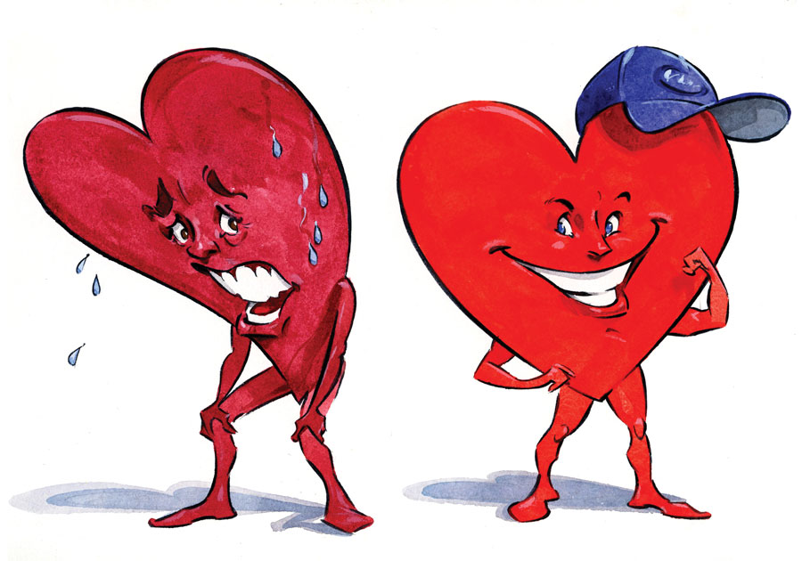
Predicting Heart Disease In Human Beings Through the Lens Of Machine Learning
Machine Learning Capstone Project
Behrooz Keshavarzi
November 2022

Slide 2
Dataset
Dataset downloaded from university of California, Irvine machine learning repository.
The data collected from 3 different sources : Cleveland, Hungary, and Switzerland
It has 720 samples and 14 features.
Features include :
Age
Gender
Chest pain type
Resting blood pressure (mm Hg)
Serum cholesterol (mg/dl)
Fasting blood sugar
Resting electrocardiographic results
Maximum heart rate achieved
Exercise induced angina
ST depression induced by exercise relative to rest
The slope of the peak exercise ST segment
Number of major vessels (0-3) colored by fluoroscopy
Thal??
Diagnosis of heart disease

Slide 3
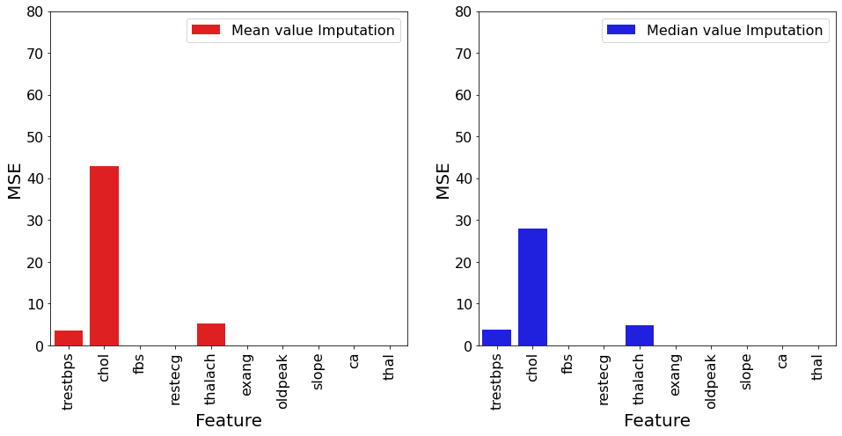
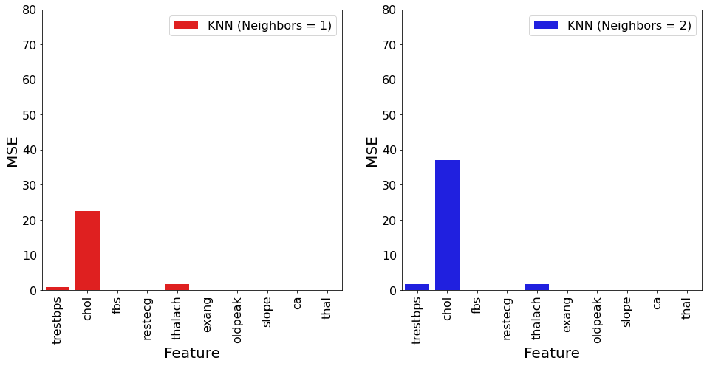
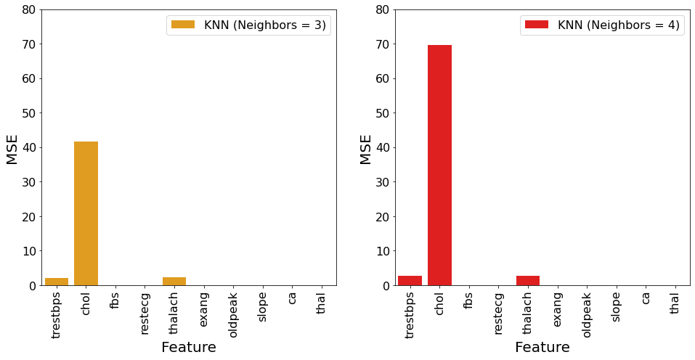
Dataset. Missing values
Ca | 413
Thal | 320
Slope | 207
Fbs | 83
Chol | 23
Pldpeak | 6
Trestbps | 3
Restecg | 2
Thalach | 2
Exang | 2
There are 422 samples (59% of total sample) that have at least one feature missed.
Machine learning models can’t work with missing values.
Three approaches were investigated to fill missed values:
Fill with mean values
Fill with median values
Fill with KNN (K nearest neighborhoods)

Slide 4
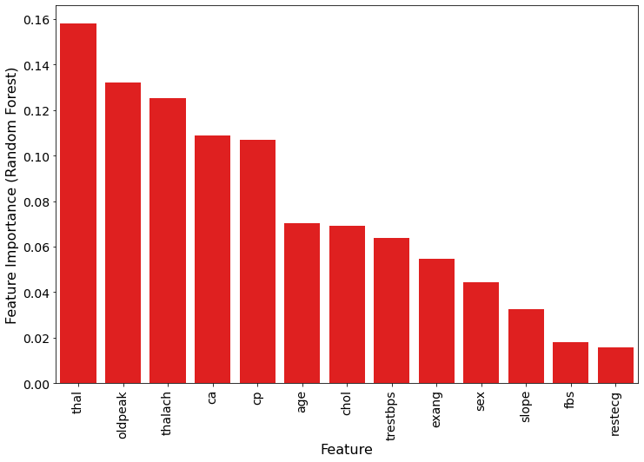
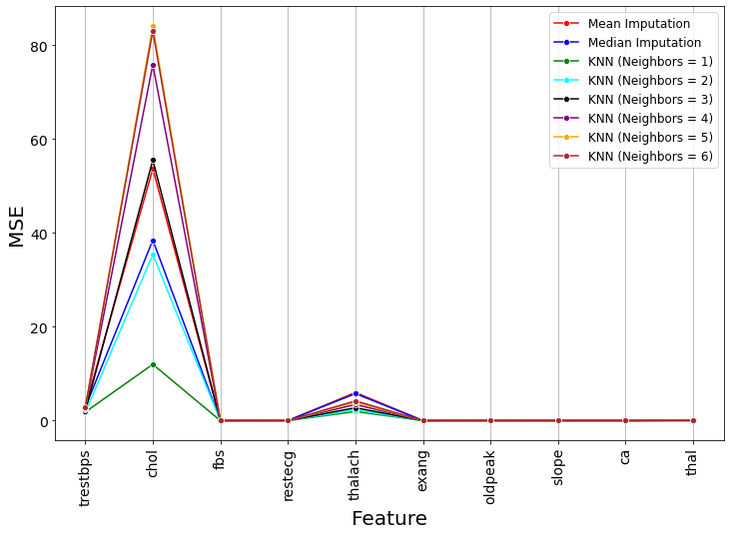
Dataset. Missing values

Slide 5
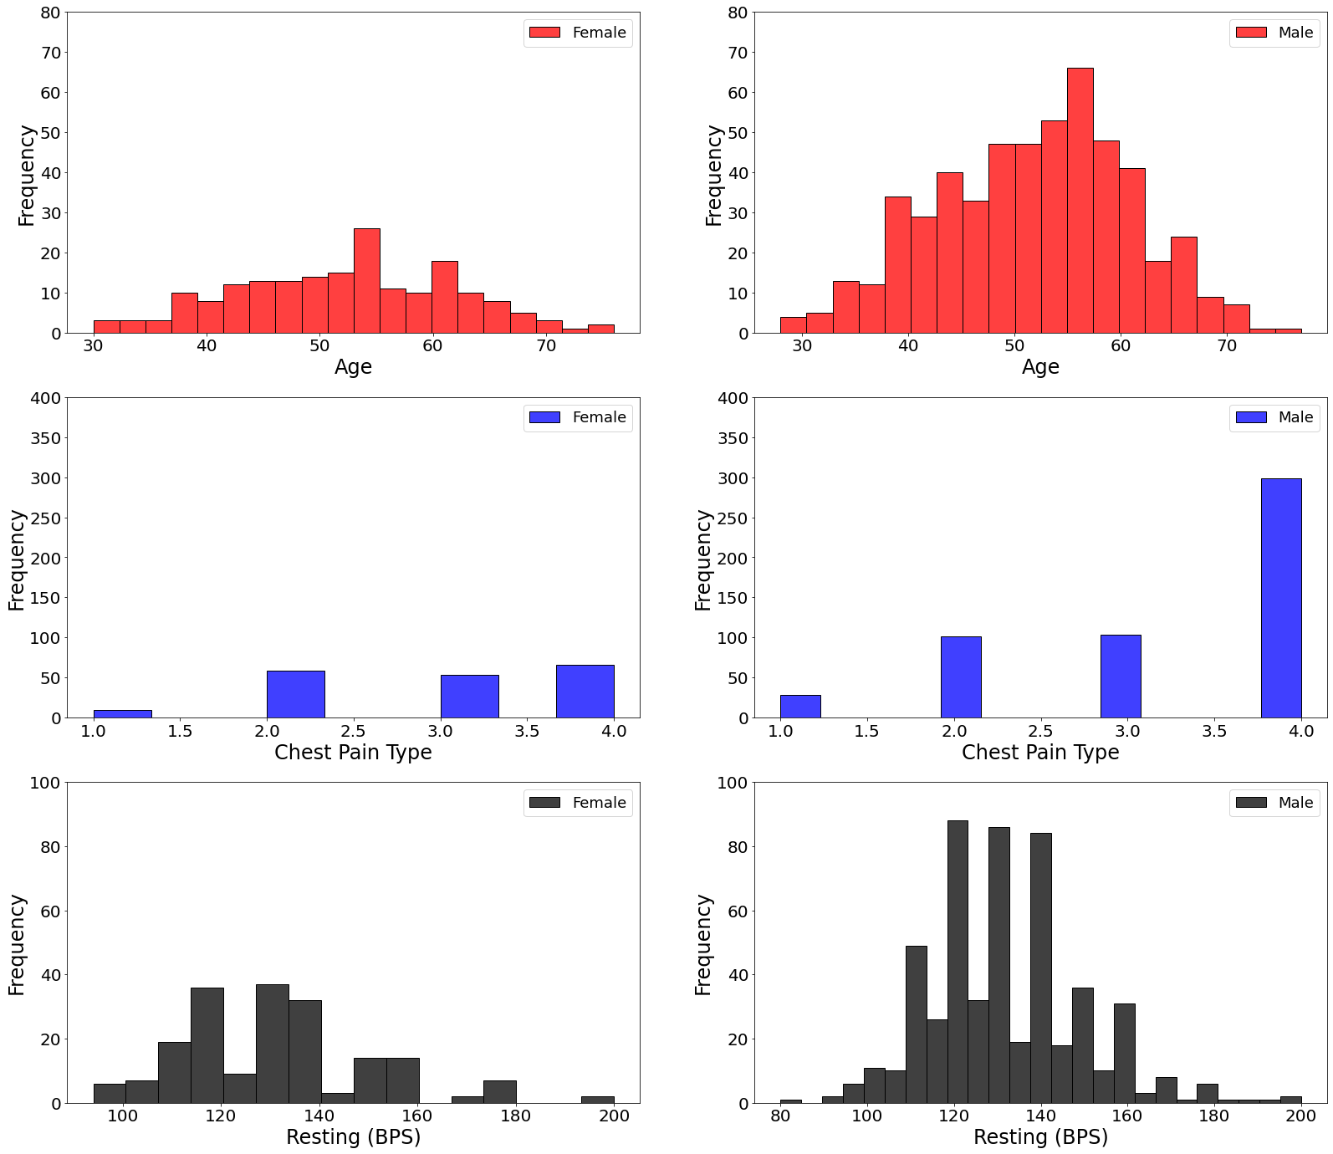
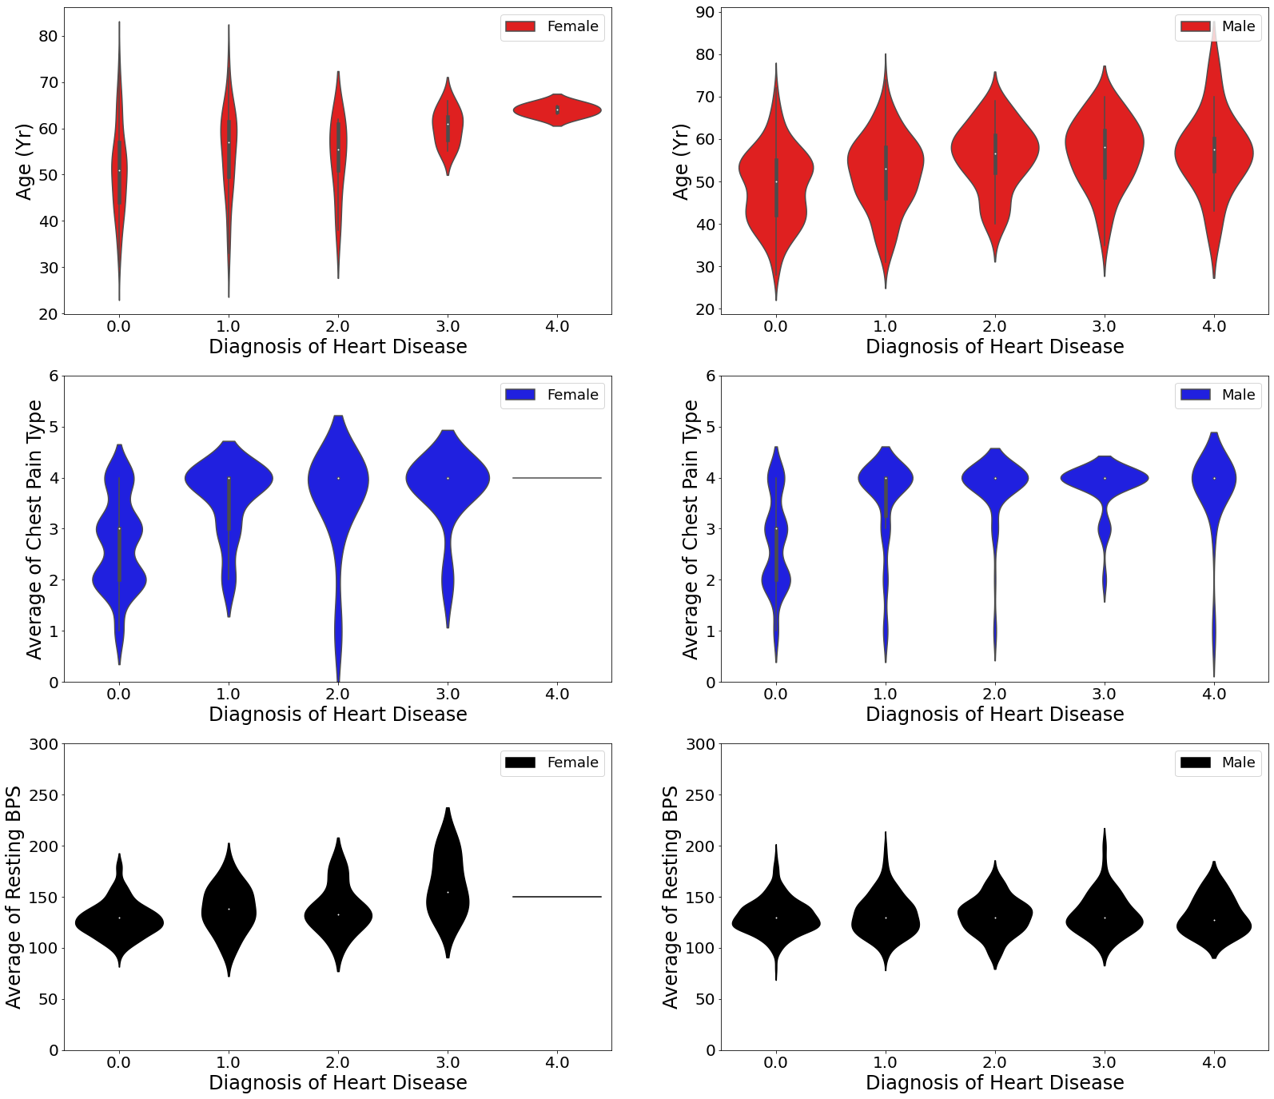
Exploratory Data Analysis

Slide 6
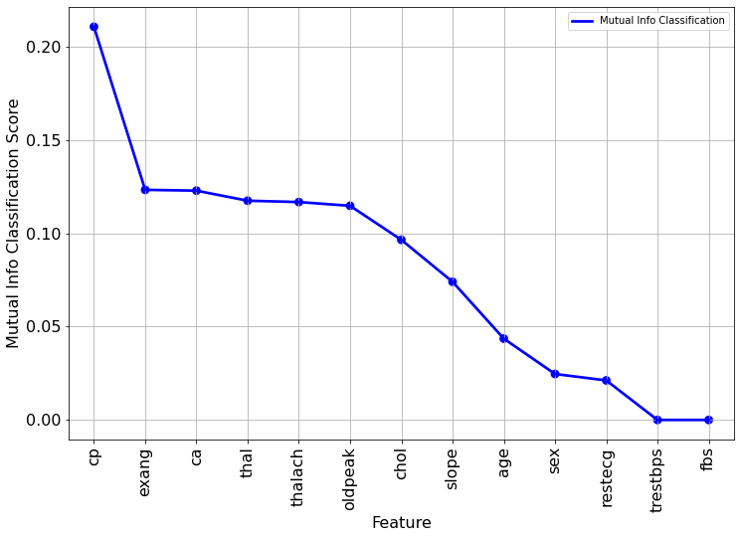
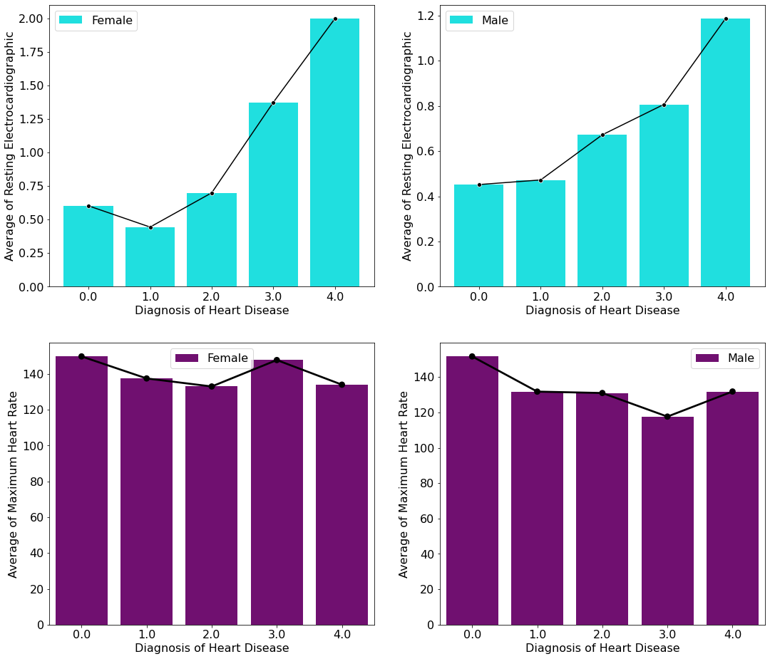
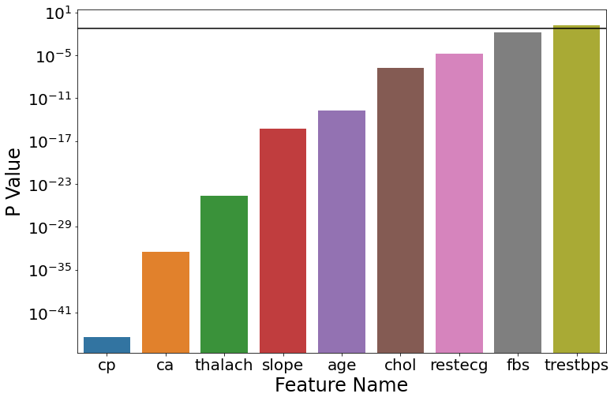
Exploratory Data Analysis

Slide 7
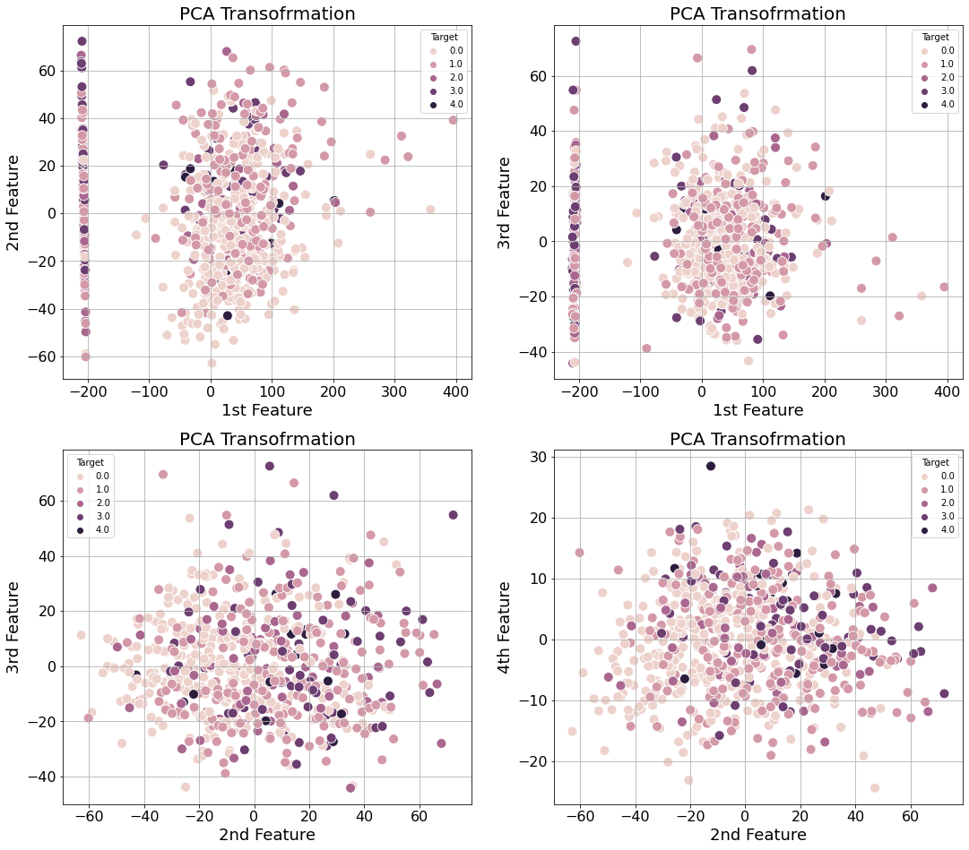
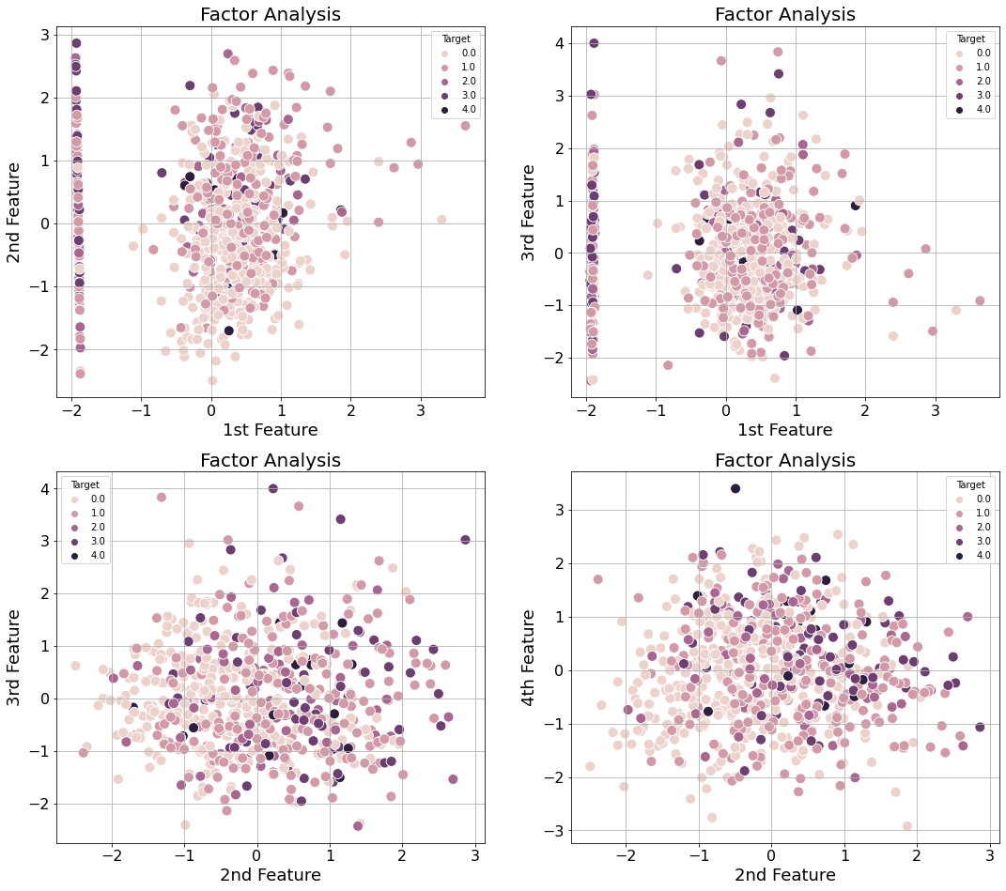
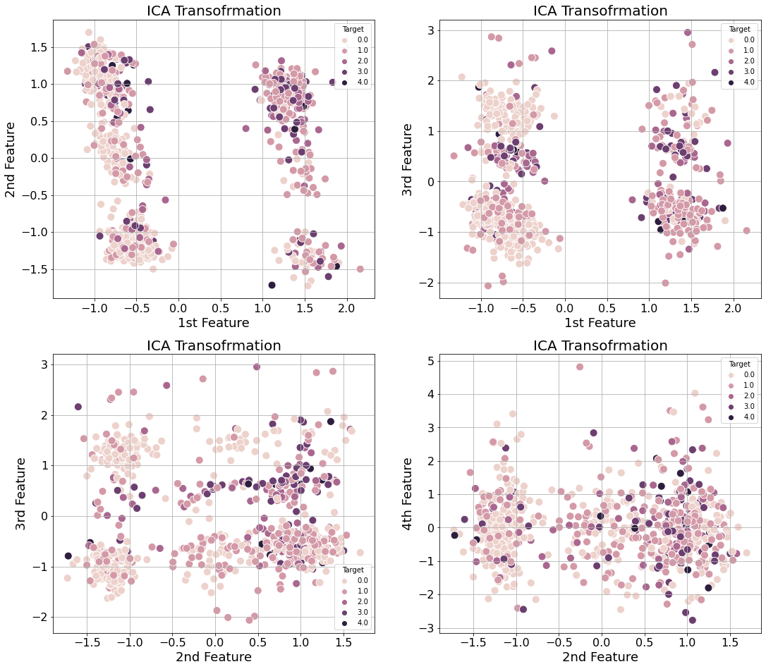
Exploratory Data Analysis

Slide 8
Machine Learning Models
Logistic Regression
Decision tree
Random Forest
Support vector classification
Discriminate analysis (LDA, QDA, GNB)
Gradient boosting
Xgboost
Four datasets were used to study the performance of machine leaning models.
Confusion matrix is used to assess model’s performance for each class.
Precision, recall, and ROC curve are used to see model’s performance as a function of threshold values.

Slide 9
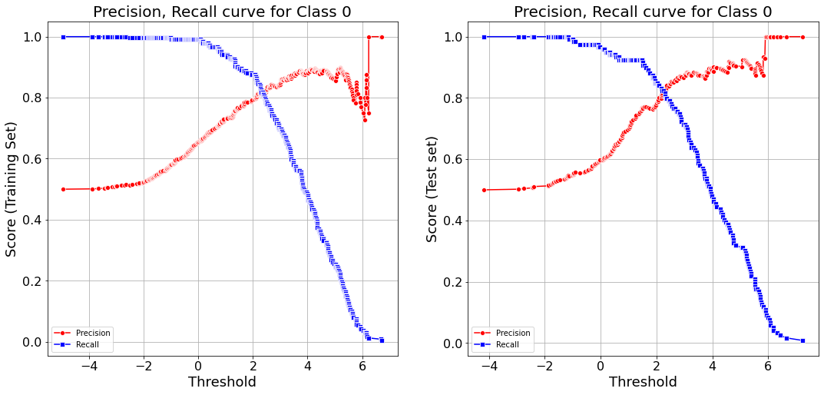
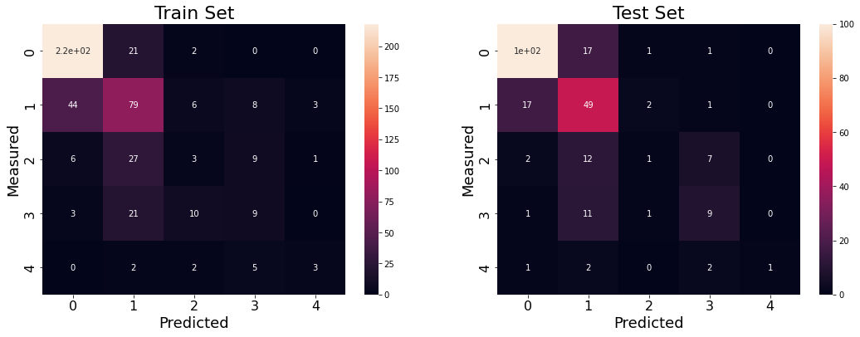
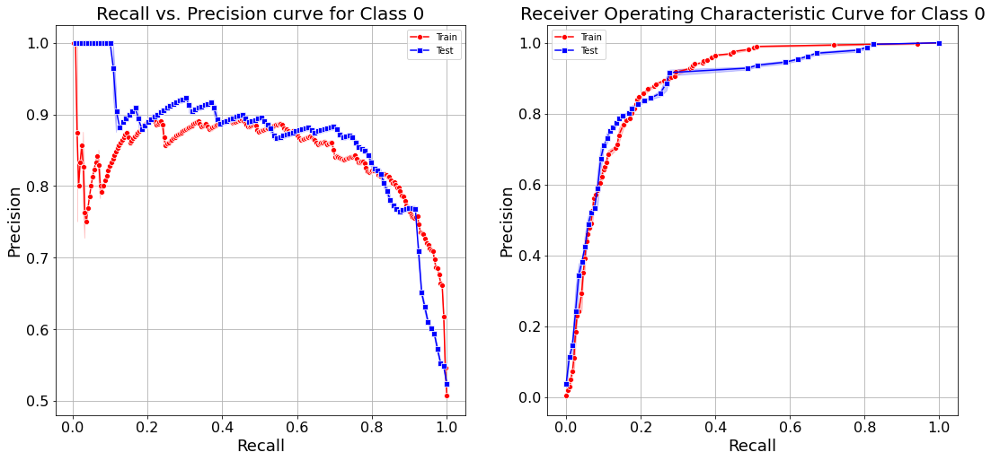
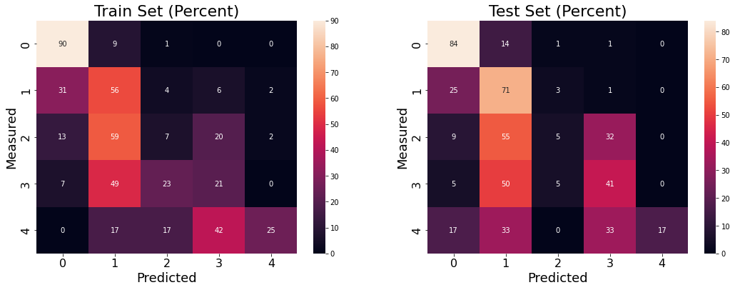
Machine Learning Models. Logistic regression
AUC = 0.89
AUC = 0.88
Train set size = 482, Number of cases predicted correctly for classes :
1)220 2)79 3)3 4)9 5)3
Accuracy is : (220+79+3+9+3)/482 = 65%

Slide 10
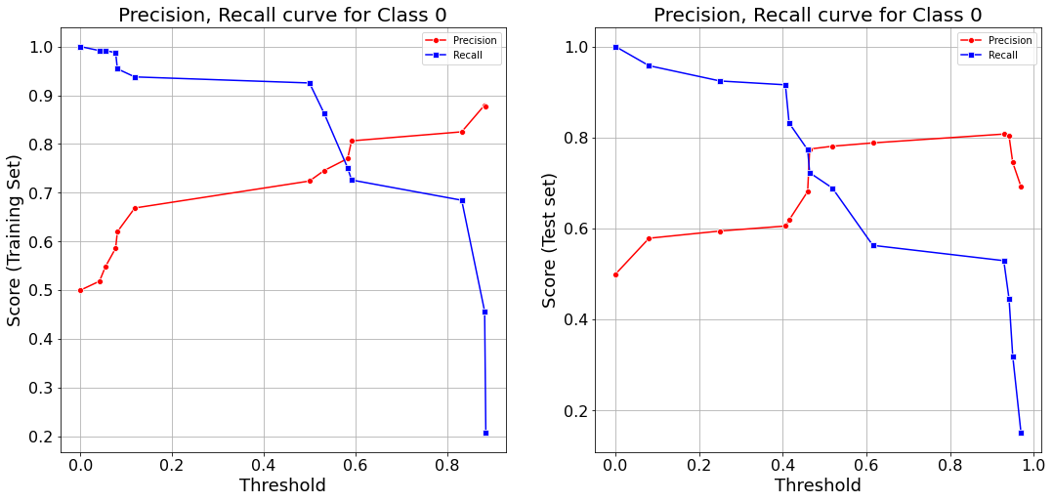
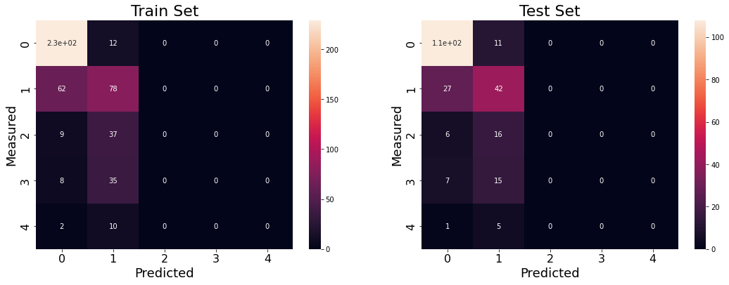
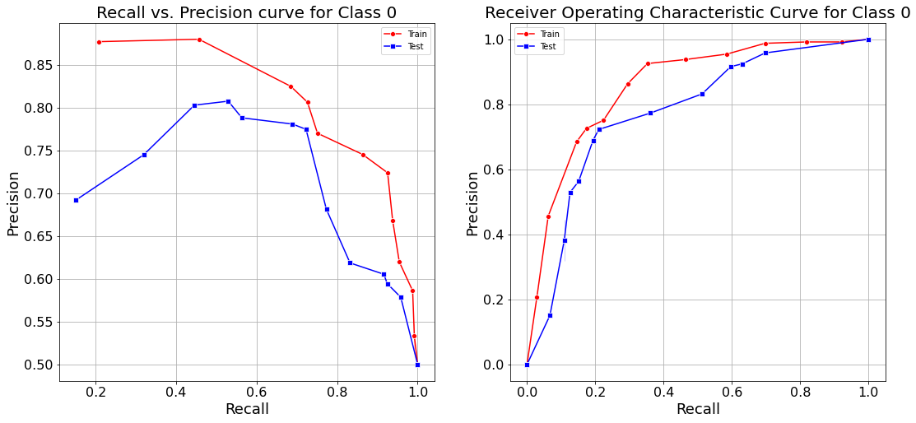
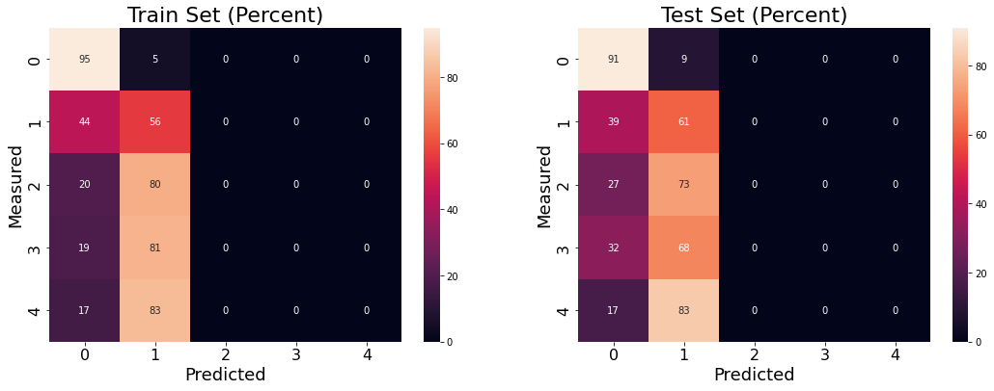
Machine Learning Models. Decision Tree
AUC = 0.85
AUC = 0.77

Slide 11
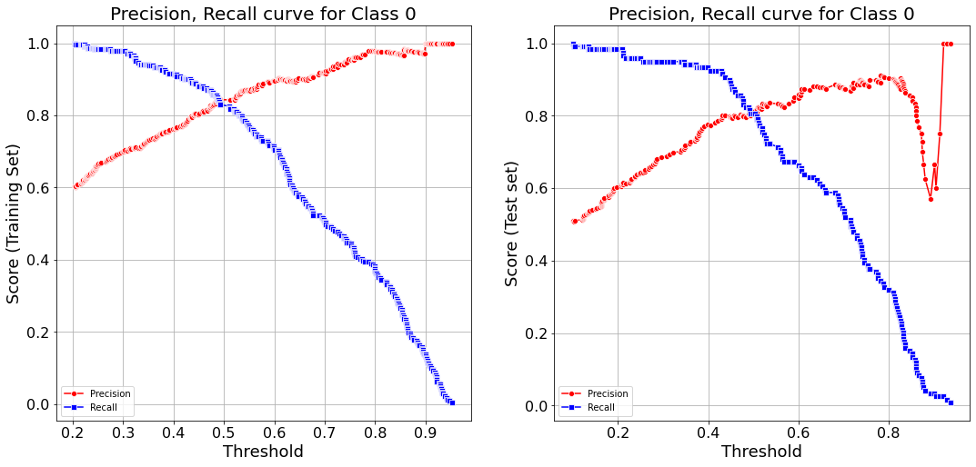

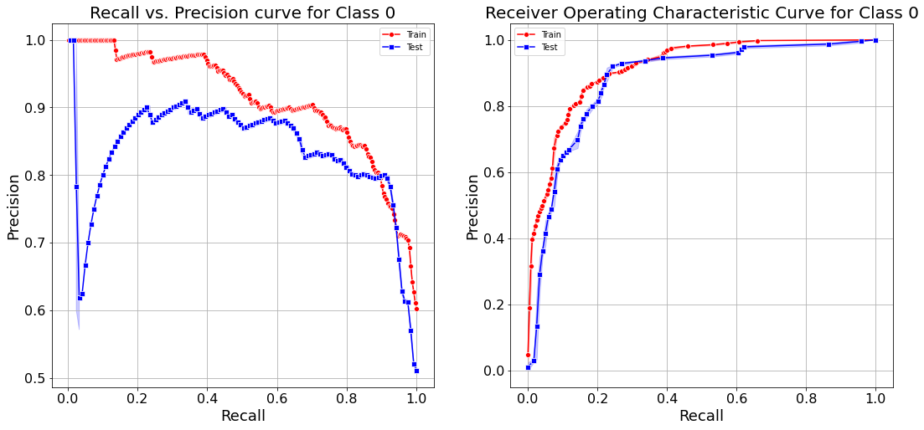
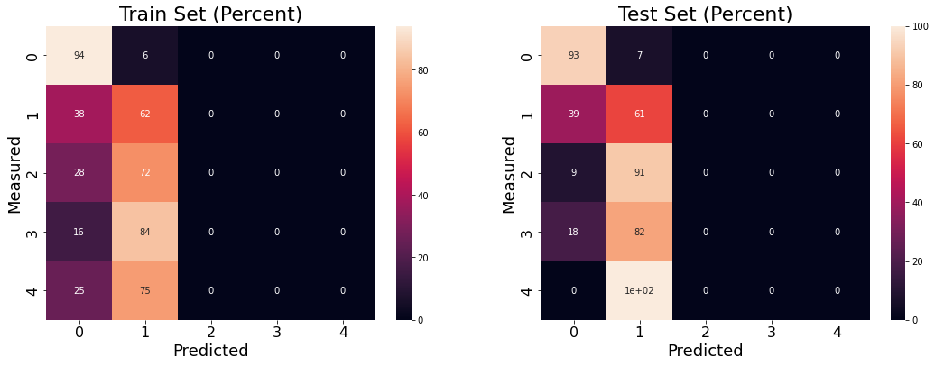
Machine Learning Models. Random Forest
AUC = 0.92
AUC = 0.88

Slide 12
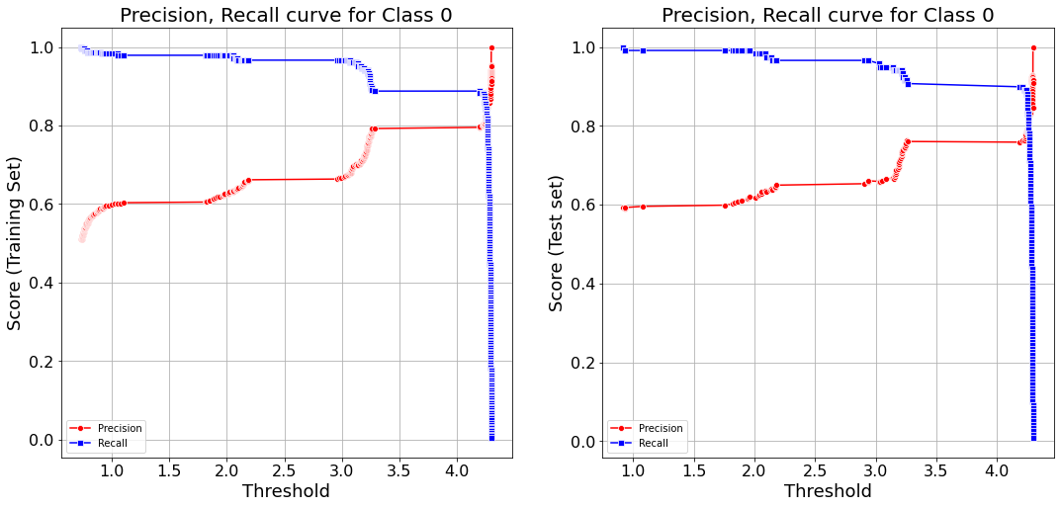
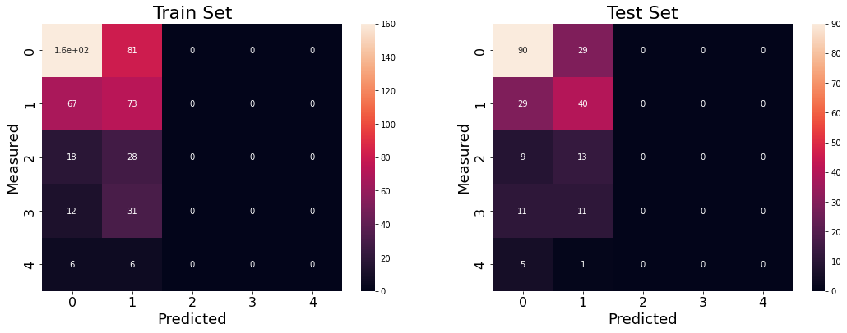
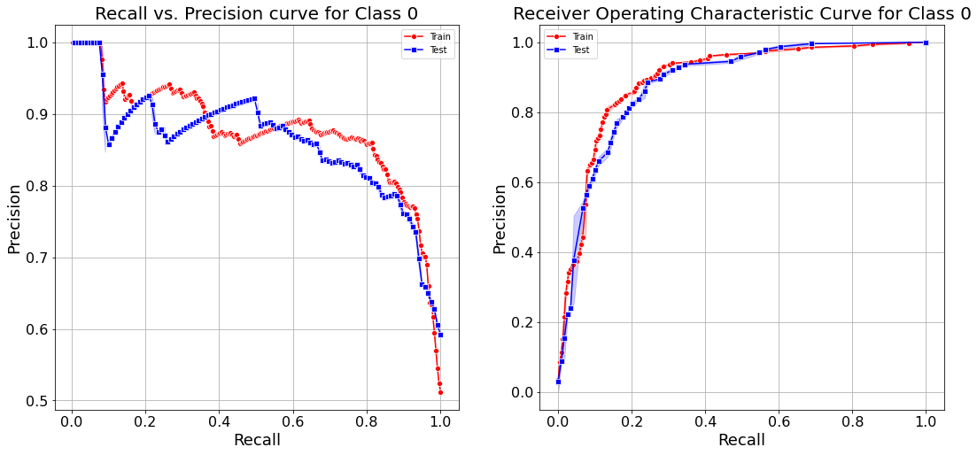
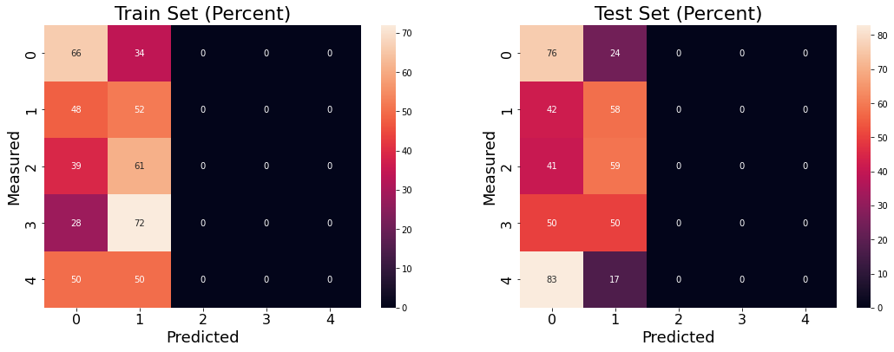
Machine Learning Models. Support Vector Classification
AUC = 0.89
AUC = 0.88

Slide 13
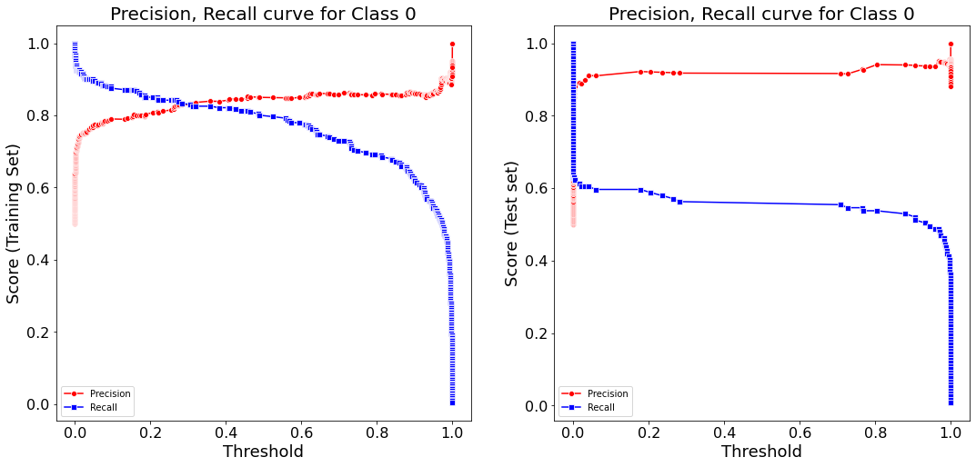
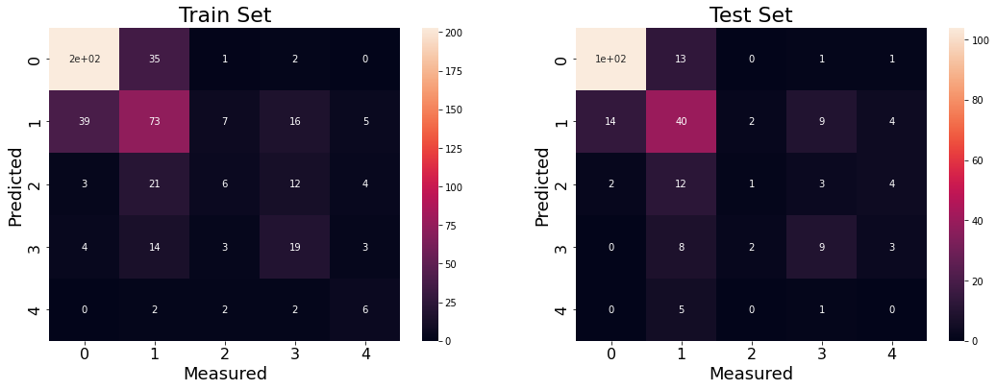
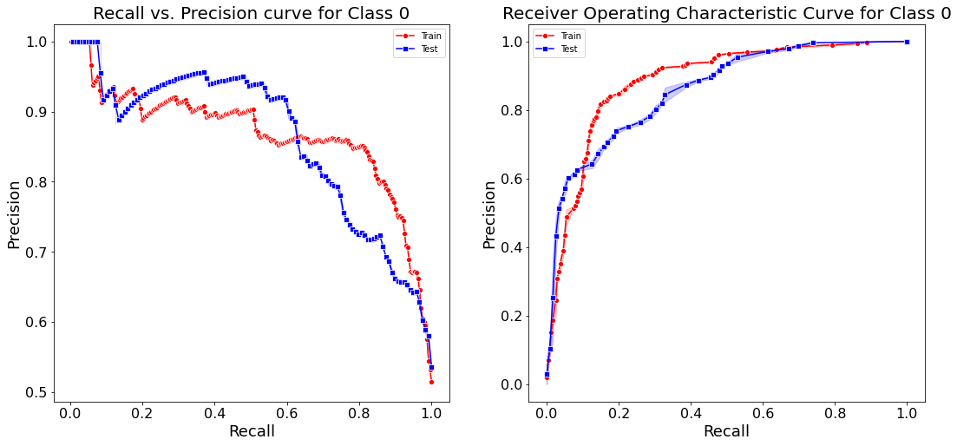
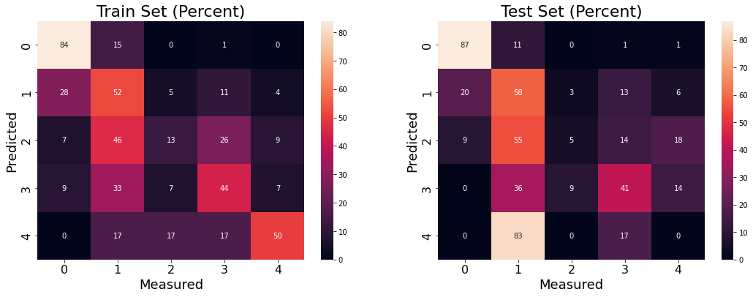
Machine Learning Models. Discriminate Analysis
AUC = 0.89
AUC = 0.86

Slide 14
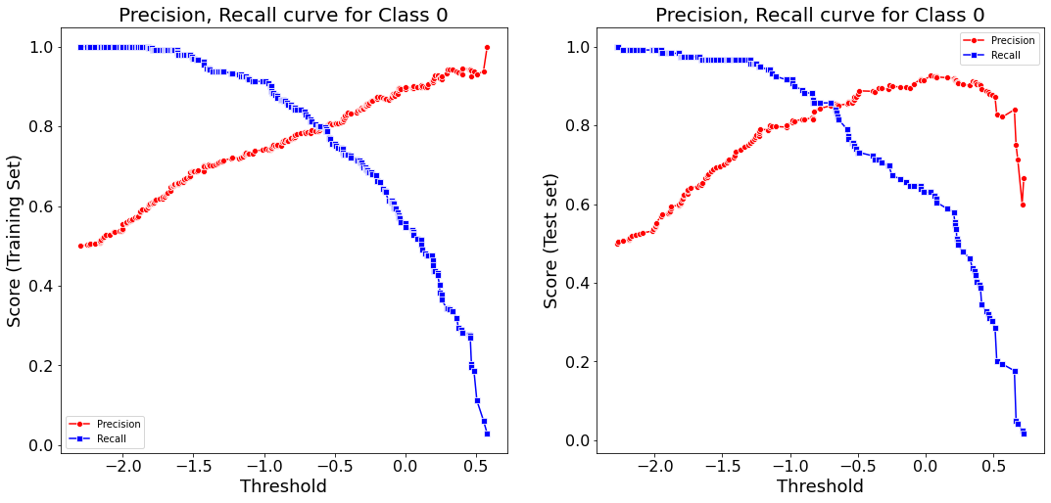
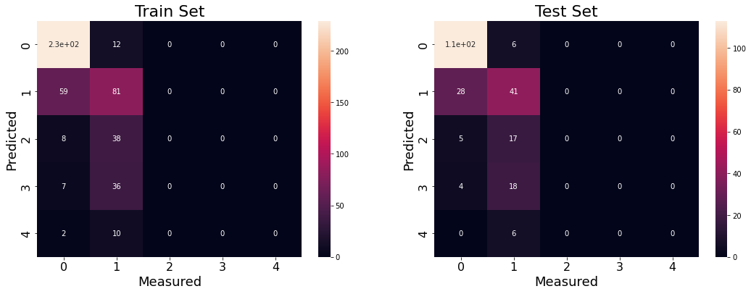
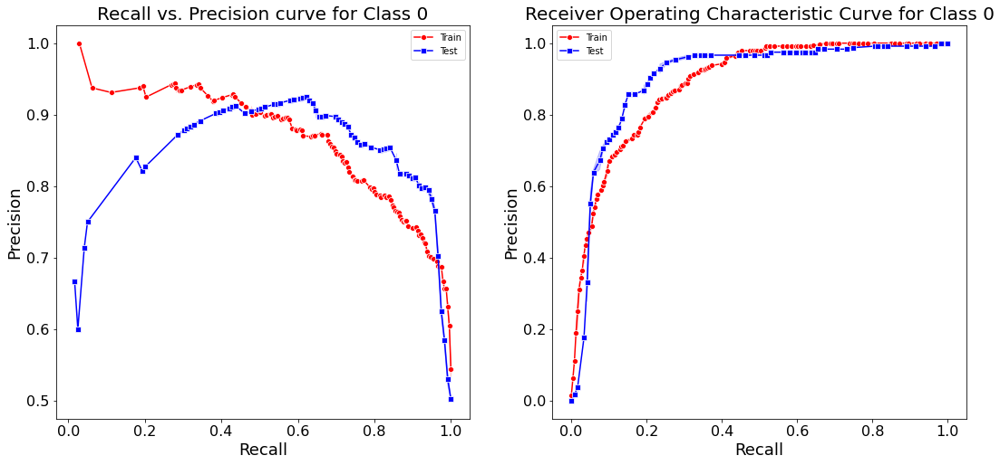
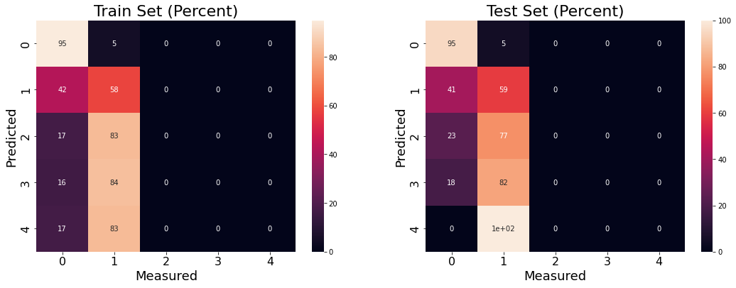
Machine Learning Models. Gradient Boosting
AUC = 0.89
AUC = 0.90

Slide 15
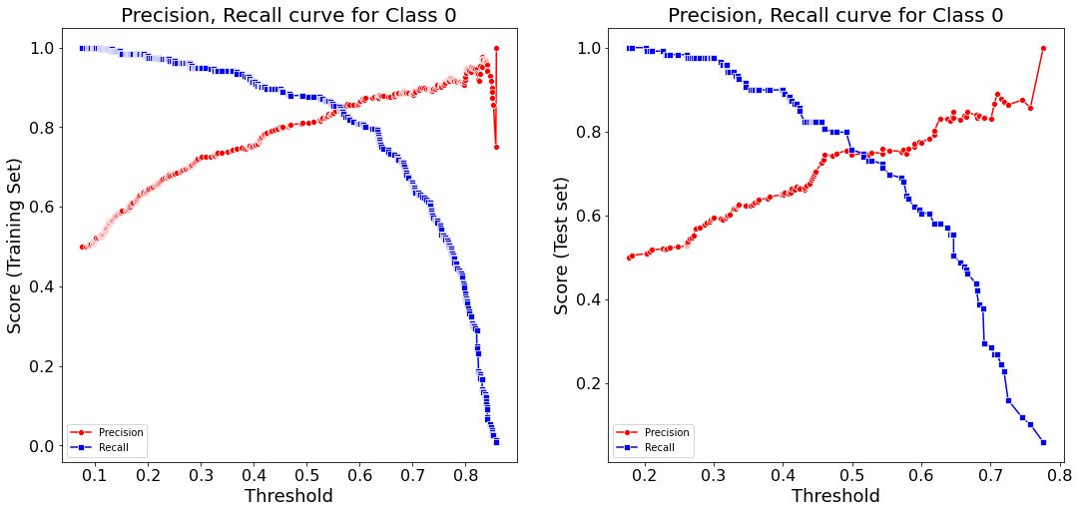
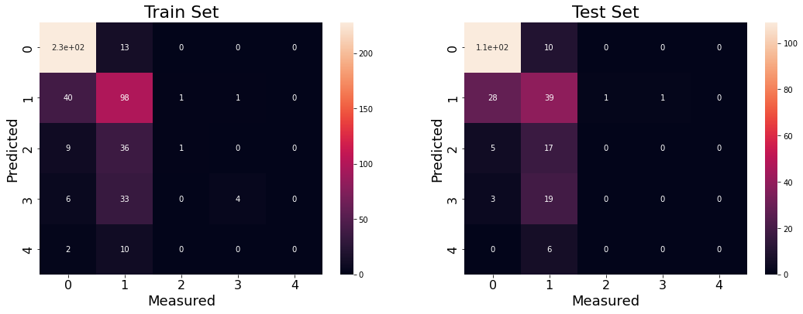
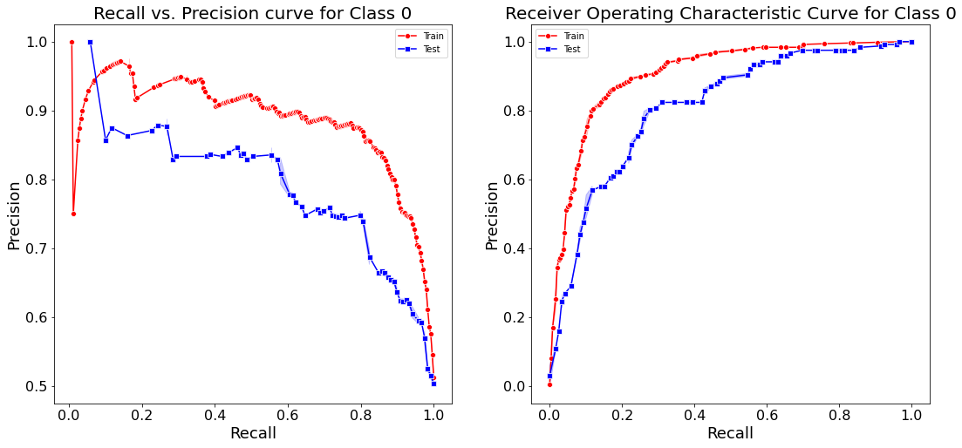
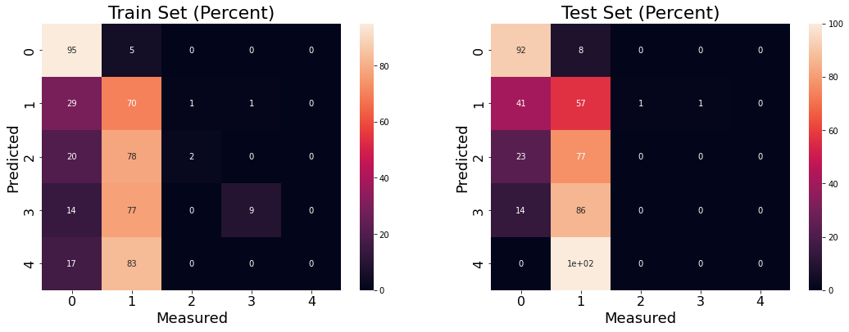
Machine Learning Models. XGBoost
AUC = 0.91
AUC = 0.81

Slide 16
Machine Learning Models. Stacking
Logistic regression
Random forest
Support vector classification
Gradient boosting
KNN
Logistic Regression
R²_{train} = 0.70
R²_{test} = 0.67
Logistic regression
Random forest
Support vector classification
Gradient boosting
KNN
Random forest
R²_{train} = 0.75
R²_{test} = 0.63
Logistic regression
Random forest
Support vector classification
Gradient boosting
KNN
GNB
Random forest
R²_{train} = 0.76
R²_{test} = 0.63

Slide 17
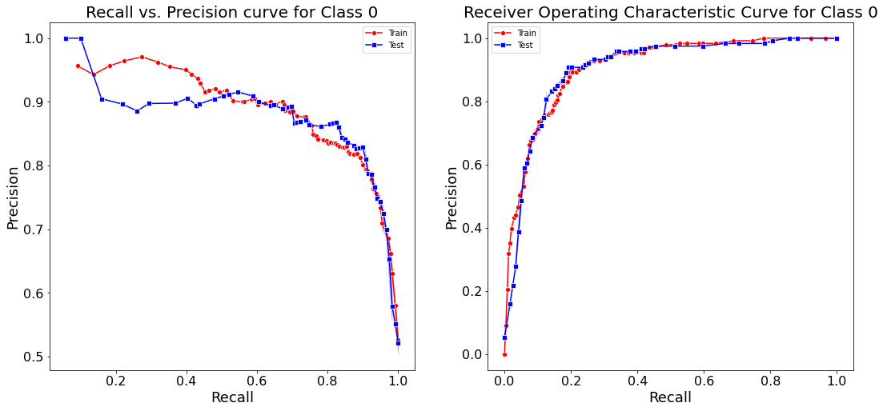
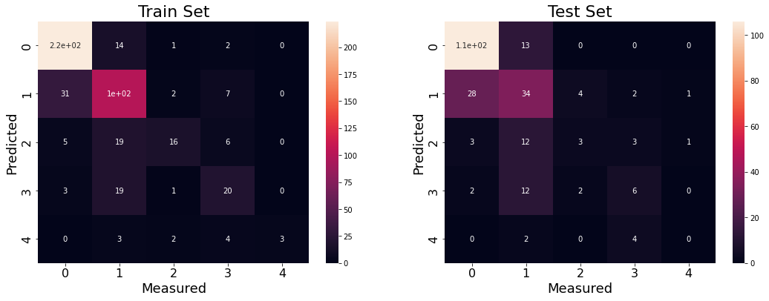
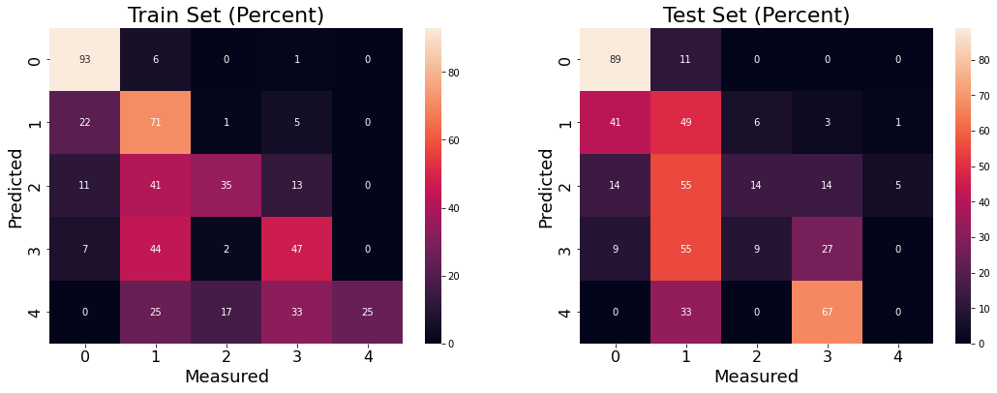
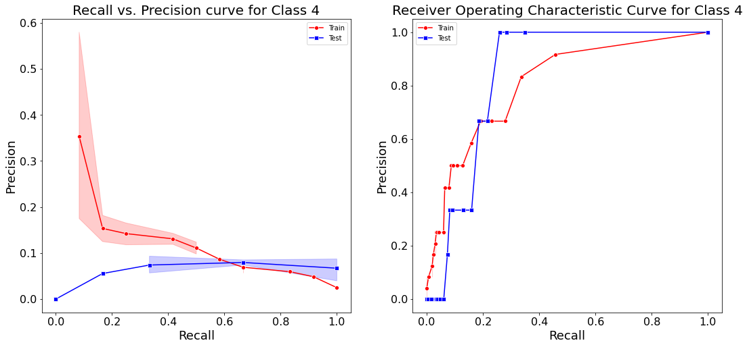
Machine Learning Models. Stacking, contd.

Slide 18
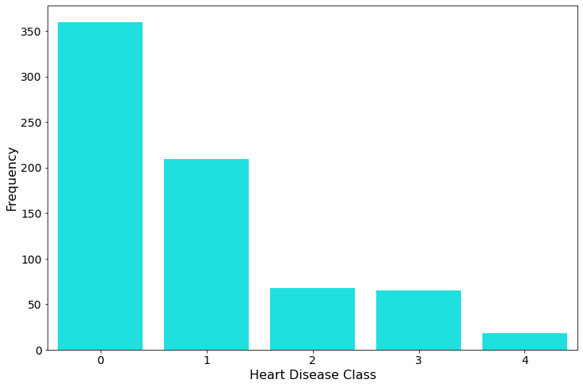
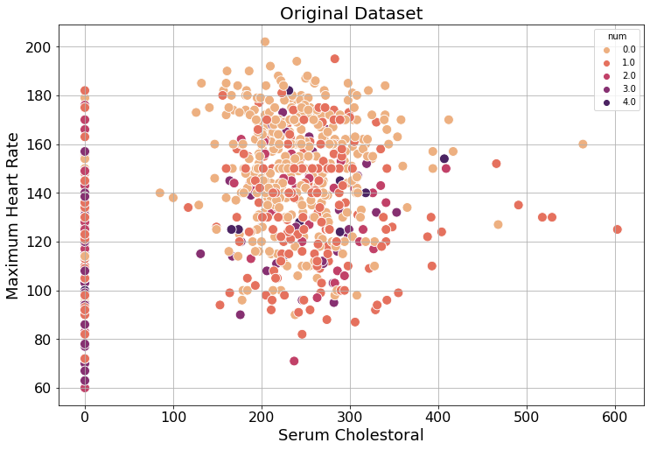
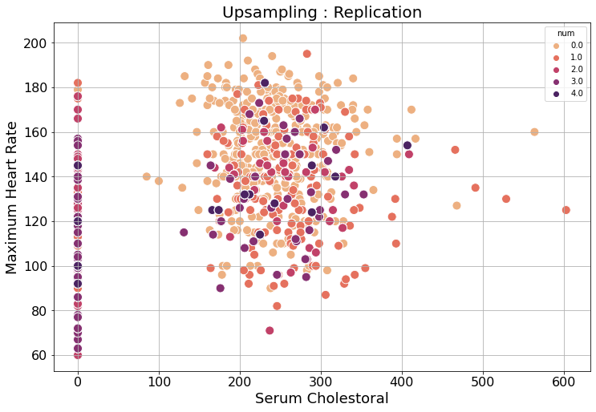
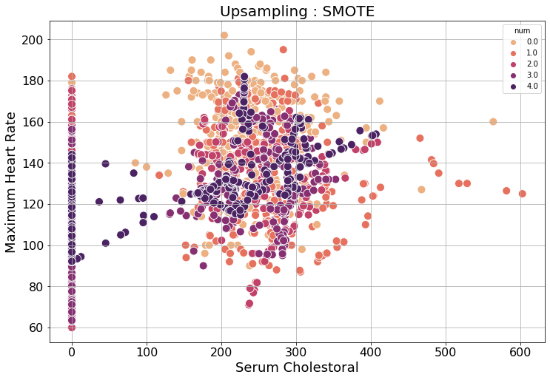
Machine Learning Models. Expanding the Dataset

Slide 19
Machine Learning Models. Expanding the Dataset
Up sampling : Replicating Data
Model | R²_{train} | R²_{test}
Logistic regression | 0.46 | 0.46
Random forest | 0.71 | 0.71
Discriminate analysis (QDA) | 0.63 | 0.63
Gradient boosting | 0.76 | 0.76
Xgboost | 0.76 | 0.76
Original Dataset
Model | R²_{train} | R²_{test}
Logistic regression | 0.45 | 0.45
Random forest | 0.62 | 0.58
Discriminate analysis (QDA) | 0.53 | 0.53
Gradient boosting | 0.44 | 0.44
Xgboost | 0.57 | 0.57
Fit on up sampled dataset
Get score on original dataset
Up sampling : SMOTE
Model | R²_{train} | R²_{test}
Logistic regression | 0.51 | 0.51
Random forest | 1.0 | 0.85
Discriminate analysis (QDA) | 0.65 | 0.65
Gradient boosting | 0.97 | 0.79
Xgboost | 1.00 | 0.83
Up sampling : SMOTE
Model | R²_{train} | R²_{test}
Logistic regression | 0.58 | 0.58
Random forest | 0.91 | 0.91
Discriminate analysis (QDA) | 0.64 | 0.64
Gradient boosting | 0.85 | 0.85
Xgboost | 0.90 | 0.90
Fit on up sampled dataset
Get score on original dataset

Slide 20
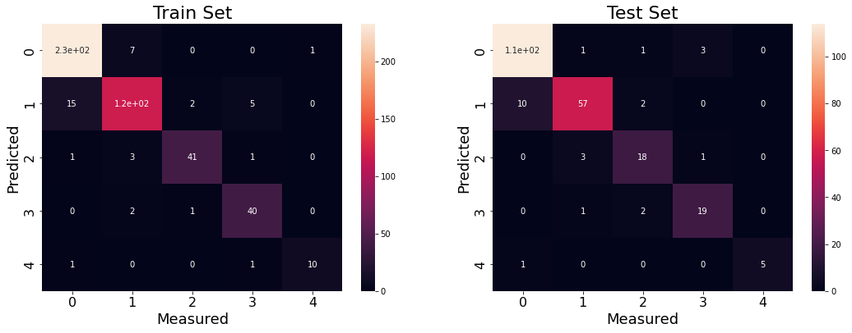



Machine Learning Models. Expanding the Dataset. Contd
AUC = 0.91
AUC = 0.89
AUC = 0.71
AUC = 0.66

Slide 21
Machine Learning Models. Expanding the Dataset + Stacking
Random forest
Gradient boosting
Xgboost
Random forest
R²_{train} = 0.92
R²_{test} = 0.92
Random forest
Gradient boosting
Xgboost
Xgboost
R²_{train} = 0.92
R²_{test} = 0.92

Slide 22

Machine Learning Models. Feature Importance

